Slide 1


Slide 2
Major Project – II Potato disease classification using deep learning Potato disease classification using deep learning
MEMBER’S NAME | ROLL NO | SAP ID | BRANCH
Nishant Raj | R103218183 | 500070098 | BUSINESS ANALYTICS & OPT
Shreya Sharma | R103219030 | 500077712 | BUSINESS ANALYTICS & OPT
Shivani Saran | R103219018 | 500075219 | BUSINESS ANALYTICS & OPT
VANIJ SINGLA | R103219023 | 500075979 | BUSINESS ANALYTICS & OPT
MEMBER’S NAME | ROLL NUMBER | SAP ID | BRANCH
GURUDAS TOLANI
AYUSHI CHAKRABORTY
NISHANT RAJ
Under the guidance of
Dr. Tanupriya Choudhary

Slide 3
CONTENTS
Introduction
Motivation
Literature Review
Problem Statement
Objective
Methodology
Test cases
Result
Application
References

Slide 4
INTRODUCTION
Potatoes are a crucial crop for agriculture and food security.
Diseases have a significant impact on potato crop yield and quality.
The use of deep learning for disease detection in agriculture has shown promising results.
The objective of this project is to develop an accurate and efficient model for potato disease classification using deep learning.

Slide 5
MOTIVATION
Potatoes are one of the most widely consumed and important crops in the world. However, they are susceptible to various diseases that can cause significant yield losses and affect their quality. Traditional methods of detecting and diagnosing potato diseases can be time-consuming and expensive. Hence, there is a need for an automated and accurate system to identify and classify different types of potato diseases.

Slide 6
LITERATURE REVIEW
[1]The classification of potato diseases using deep learning has gained significant attention in recent years. Various studies have proposed different deep-learning architectures and techniques for potato disease classification. In this literature review, we summarize some of the key works in this field.
[2]A deep convolutional neural network (CNN) was proposed for potato disease classification. The authors used transfer learning to adapt the VGG-16 architecture for their dataset of potato images. The results showed that the proposed model achieved high accuracy in classifying different types of potato diseases.
[3]A deep neural network was used for potato disease classification. The authors proposed a customized network architecture that includes multiple convolutional and pooling layers. The network was trained on a dataset of potato images that includes various types of diseases. The results showed that the proposed model achieved high accuracy in potato disease classification.

Slide 7
PROBLEM STATEMENT
Potato crops are susceptible to various diseases, which can significantly impact their yield and quality.
Current methods for detecting and classifying potato diseases are time-consuming and require expertise.
The development of an accurate and efficient model for potato disease classification using deep learning can improve disease detection and help farmers make informed decisions about crop management.

Slide 8
OBJECTIVE
Develop an accurate and efficient model for potato disease classification using deep learning techniques.
Improve disease detection in potato crops and aid in making informed decisions about crop management.
Reduce the time and expertise required for disease detection and classification.
Explore potential applications of the model in agriculture and crop management.

Slide 9
ALGORITHM
Convolutional Neural Network (CNN) is the primary algorithm used in this project for potato disease classification.
CNN is a type of deep learning architecture that has shown high performance in image classification tasks.
The CNN consists of several layers, including convolutional, pooling, and fully connected layers, that are trained to learn features from the input images.
The output layer of the CNN is a softmax layer, which produces a probability distribution over the disease classes.
The trained model can then classify new potato plant images into the different disease classes with high accuracy.

Slide 10
Flow Chart
Data Collection
Data Cleaning and preprocessing
Model Training
Model evaluation
Testing
Save model and upload
Create website

Slide 11
METHODOLOGY
Collect a dataset of potato plant images, including both healthy and diseased plants.
Preprocess the dataset by resizing, augmenting, and normalizing the images.
Split the dataset into training and testing sets.
Design a deep learning architecture, such as a convolutional neural network (CNN), for disease classification.
Train the model on the training set and optimize the hyper parameters.

Slide 12
Evaluate the model's performance on the testing set using various metrics, such as accuracy.
Visualize the model's performance.
Discuss the potential applications of the model in agriculture and crop management, as well as future directions for expanding and improving the model.

Slide 13
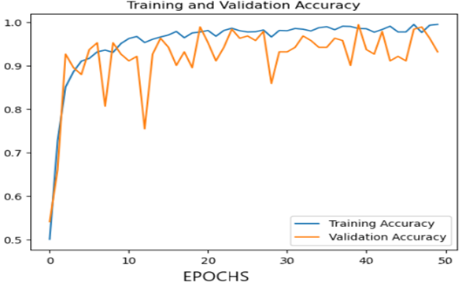
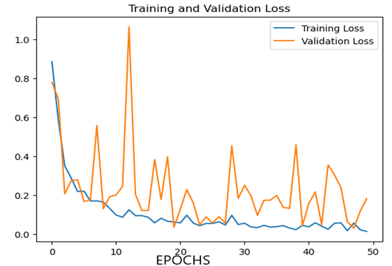

RESULT
Test set score:

Slide 14
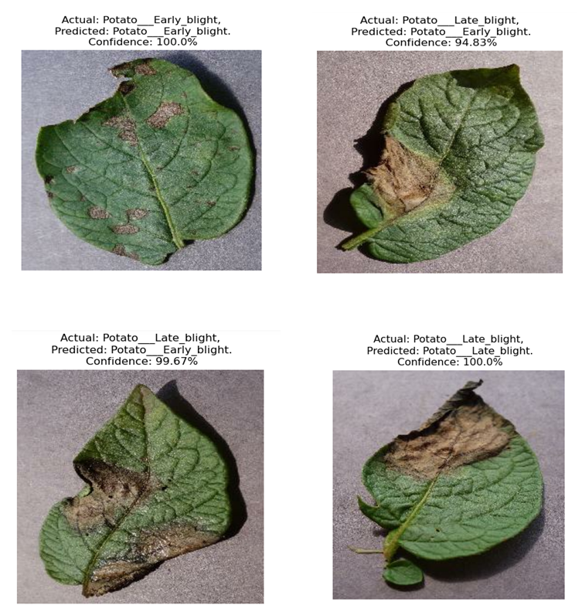
Test Cases

Slide 15
APPLICATION
Early Detection and Prevention of Potato Diseases.
Improved Crop Yield and Quality.
Reduced Use of Pesticides.
Improved Disease Management Strategies.
Automated Monitoring of Potato Diseases.
Transferability to Other Crops.

Slide 16
REFERENCES
https://journals.sagepub.com/doi/full/10.1177/2158244018810067
https://www.slideshare.net/ghanendrasinha7/employee-attrition-rate-mba-hr-final-project-report
https://www.investopedia.com/terms/a/attrition.asp
https://www.bibliomed.org/mnsfulltext/197/197-1596008106.pdf?1634241889
https://iopscience.iop.org/article/10.1088/1757-899X/830/3/032001/meta

